Slide 1

Sprocket Central Pty Ltd
Data analytics approach
Lighthouse & Innovation Team- Tony Smith, [Senior Consultant], Aminat Odedeyi

Slide 2
Agenda
Introduction
Data Exploration
Model Development
Interpretation

Slide 3

Introduction
Sprocket Central Pty Ltd is a long-standing KPMG client whom specializes in high-quality bikes and accessible cycling accessories to riders.
Problem Statement: The marketing team is looking to improve performance and boost business.
Aim: To recommend new valuable customers which should be targeted to drive the most value for the organization.
Approach: Customer data analysis to determine trends and behaviors using:
Age distribution
Bike related purchases
Job industry
Wealth segment
Car ownership
State of Residence

Slide 4
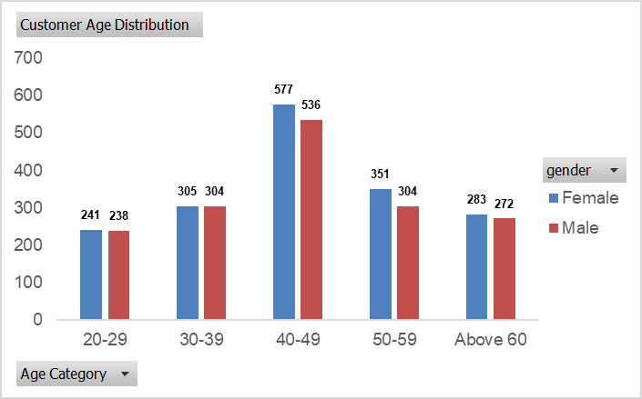
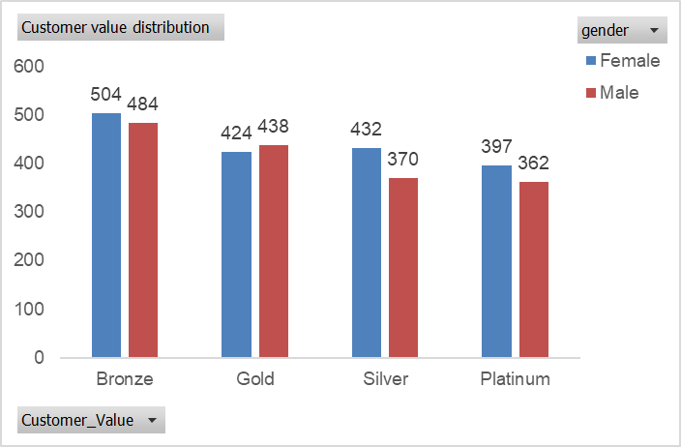
Data Exploration: Customer Age and Value Distribution
Sprocket Central’s major customers fall within the age of 30 - 59.
The age group 40 – 49 has the highest number of customers, followed by age group 50 – 59.
The age group 20 – 29 has the least number of customers.
RFM analysis shows that bronze customers have the most population.
The best- valued customers, platinum group have more females than males.
Marketing and advertising should focus more on females as the data shows female customers are more valuable.

Slide 5
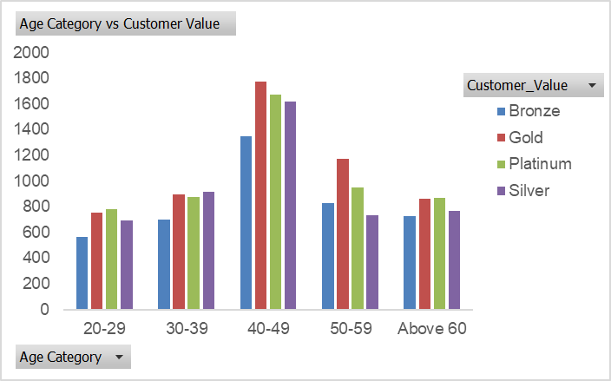
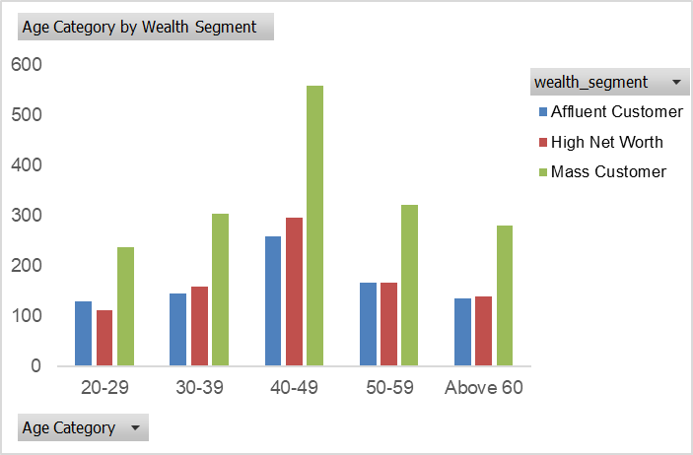
Data Exploration: Customer Age Analysis
Gold customers are the highest in age categories 40-49 and 50-59 which is closely followed by platinum customers.
In the age group 40-49, gold value has the highest number of customers, followed by platinum then silver. Bronze customers are the least in this age group.
The age group 20-29 has the lowest number of bronze, silver, gold and platinum customers. This group has more platinum customers than gold.
Across all the age groups, Mass customers accounts for the highest.

Slide 6
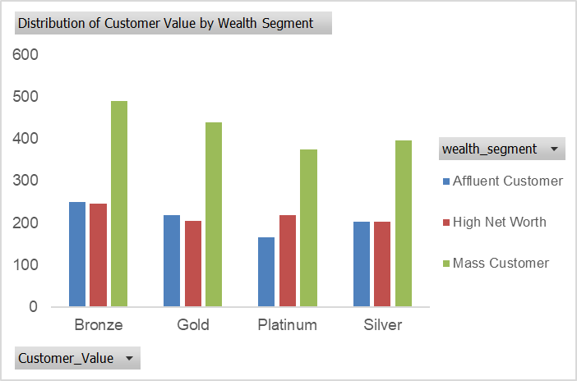
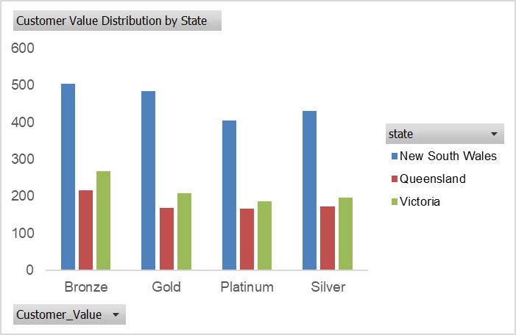
Data Exploration: Customer Valuation
In all the customer value segmentation categories, mass customers have the highest count. Mass customers should be target audience.
Platinum has the least affluent customer.
New South Wales has the highest count of customers across all the customer value segmentation followed by Victoria.
Queensland has the least distribution across the customer value segmentation.

Slide 7
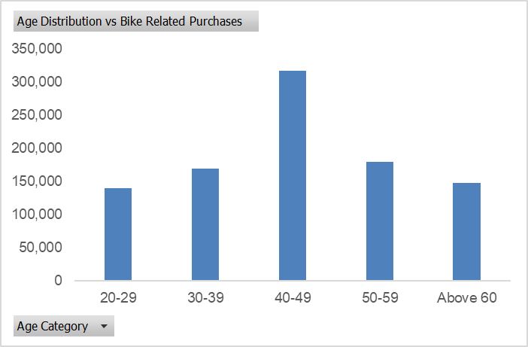
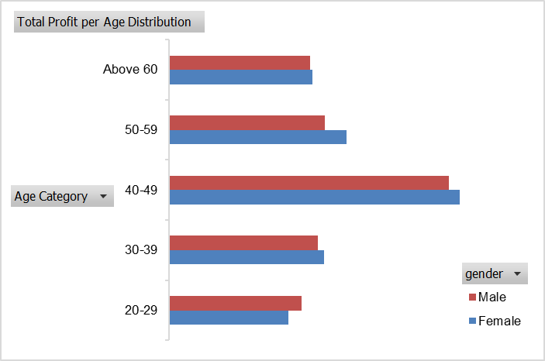
Data Exploration: Purchase Analysis
The age group 40-49 has the highest numbers of bike related purchases in last 3 years.
Customers in the age group 40 – 49 accounts for the highest total profits accrued by Sprocket Central Pty Ltd.
Female customers accounted for 50.48% of the total bike related purchases, while male customers account for 49.52%.

Slide 8
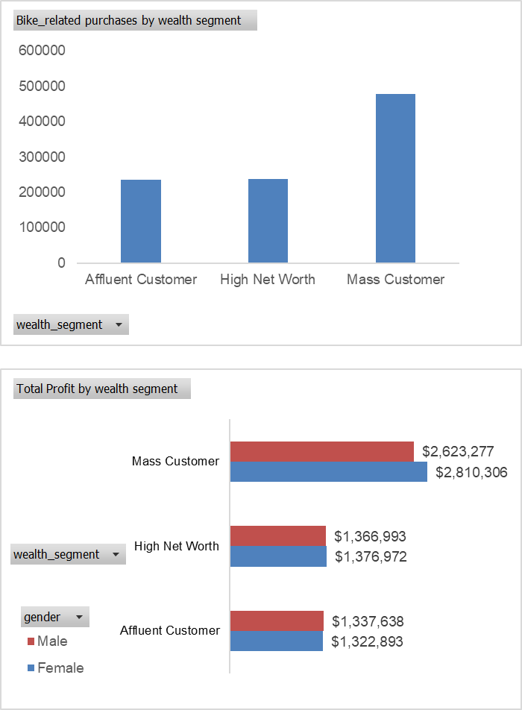
Data Exploration: Wealth Segment
The mass customers has the highest numbers of bike related purchases in last 3 years.
Affluent customers had the least bike related purchases.
Mass customers accounts for the highest total profits accrued by Sprocket Central Pty Ltd.
Female mass customers brought more profit than male mass customers.
Marketing should be focused on mass customers especially females after which high net worth customers can be considered.

Slide 9
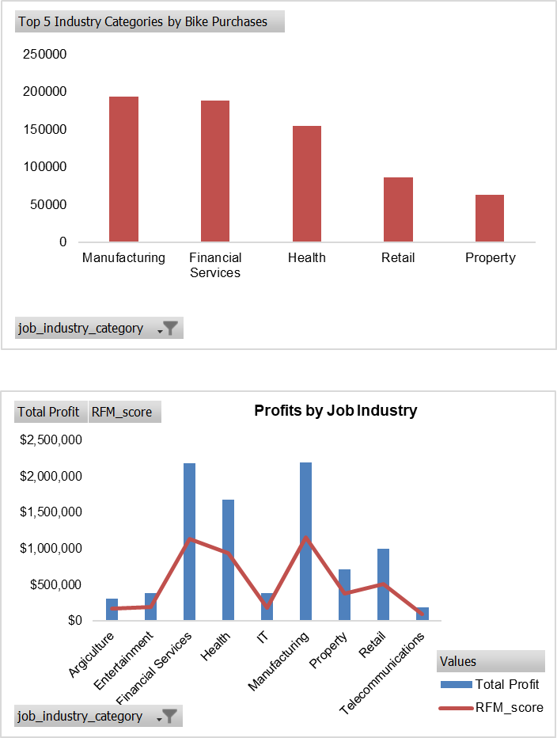
Data Exploration: Job Industry
Manufacturing, Financial Services, and Health industry categories are the top 3 in terms of bike related purchases in the past 3 years .
Manufacturing, Financial Services, and Health industry categories also remains the top 3 in terms of total profit and RFM score in the past 3 years.
Telecommunications is the least profitable industry.

Slide 10
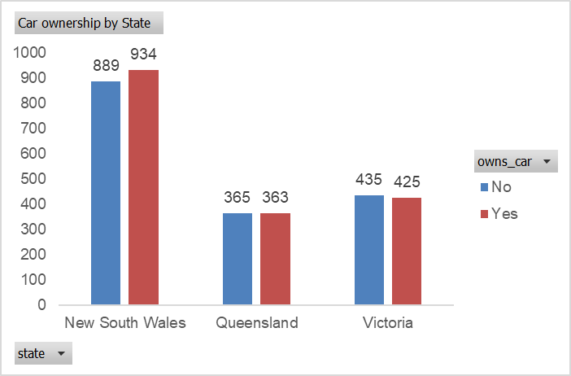
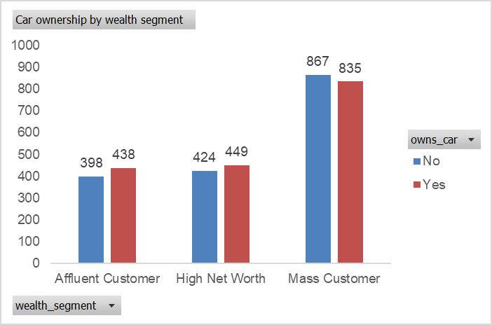
Data Exploration: Car Ownership
New South Wales (NSW) has more potential customers as there is a significant difference between the number of customers who are car owners and those who aren’t.
The mass customers also have potential market opportunities because there are more customers who don’t own cars.

Slide 11
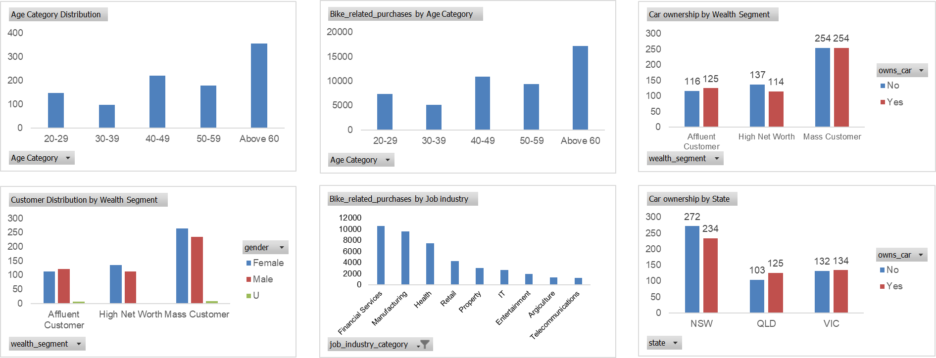
Data Exploration: New Customer Analysis

Slide 12
Model Development
High value target customers are:
Customers within the ages of 40 – 49.
Customers who working in the Financial Services, Manufacturing and Health job industry.
Highly valued returning customers especially who are females.
Customers in the mass customer wealth segment.
Customers who reside in New South Wales (NSW).

Slide 13
Interpretation
Some highly valued customers to target from the new customers list are given below:

Slide 14
THANK YOU!!!

